Slide 1


DO NOW A researcher was examining a case study of a man who was unable to speak coherent sentences. The researcher conducted brain scans, structured interviews and recorded videos of his speech to make observations. a) Identify: Subjective qualitative data 1. ________________ 2. ______________ Identify: Objective quantitative data 1.________________ b) Suggest another way to acquire objective quantitative data for this research.
Activate Prior Knowledge

Slide 2
DO NOW Define extraneous variables and confounding variables
Activate Prior Knowledge

Slide 3

Learning Intentions
I will be able to describe different extraneous variables
I will be able to identify and execute the steps required to write the discussion, conclusion and references of my investigation.
Success Criteria
I will add to my notes on extraneous variables
I will apply the steps to my investigation - writing a discussion, conclusion and references.

Slide 4
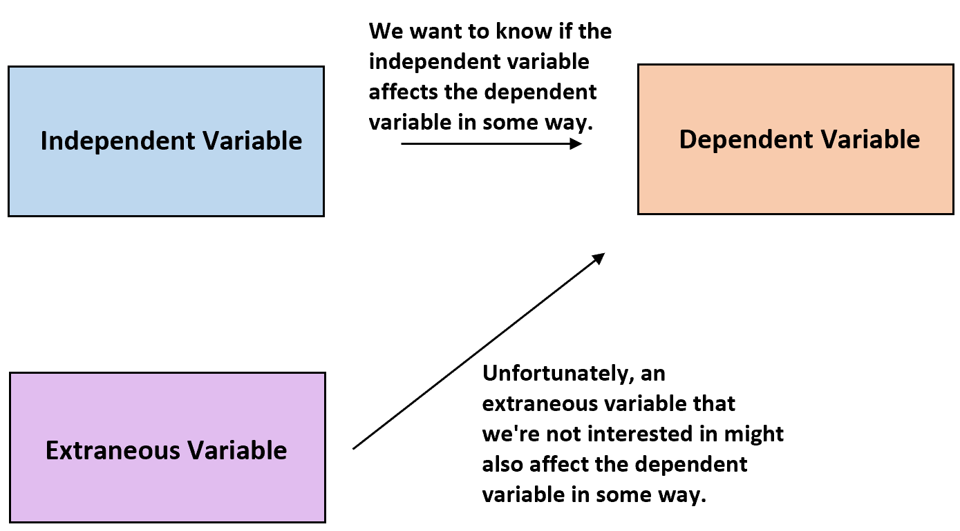
Experiments - controlling variables
Activate Prior Knowledge
To ensure that it is the IV effecting the DV
Extraneous variables – Any variable that could effect the DV and therefore effects the reliability of the results if left uncontrolled
Confounding variables – Any variable left uncontrolled that does effect the DV and therefore effects the reliability of the results

Slide 5
Extraneous variables example
Concept development
Suppose we wanted to measure the effects of Alcohol (IV) on driving ability (DV) we would have to try to ensure that extraneous variables did not affect the results. These variables could include:
• Familiarity with the car: Some people may drive better because they have driven this make of car before.
• Familiarity with the test: Some people may do better than others because they know what to expect on the test.
• Used to drinking. The effects of alcohol on some people may be less than on others because they are used to drinking.
• Full stomach. The effect of alcohol on some subjects may be less than on others because they have just had a big meal.
If these extraneous variables are not controlled they may become confounding variables, because they could go on to affect the results of the experiment.

Slide 6
Extraneous Variables
Vocabulary
Participant extraneous variables: differing individual characteristics of participants in an experiment which may impact DV.
Activate prior knowledge
Participant variables
This refers to the ways in which each participant varies from one another, and how this could affect the results e.g. mood, intelligence, anxiety, nerves, concentration etc
Situational
variables
These are aspects of the environment that might affect the participant’s behaviour, e.g. noise, temperature, lighting conditions, etc. Situational variables should be controlled so they are the same for all participants – this is called standardising the procedure
Experimenter Bias
The experimenter unconsciously conveys to participants how they should behave. They may do this by giving unintentional cue these may be very subtle.
Demand Characteristics
The personal attributes (e.g. age, gender, accent, manner etc.) of the experiment can affect the behaviour of the participants.
these are all the clues in an experiment which convey to the participant the purpose of the research.
To minimize these factors by keeping the environment as natural as possible, carefully following standardized procedures.

Slide 7
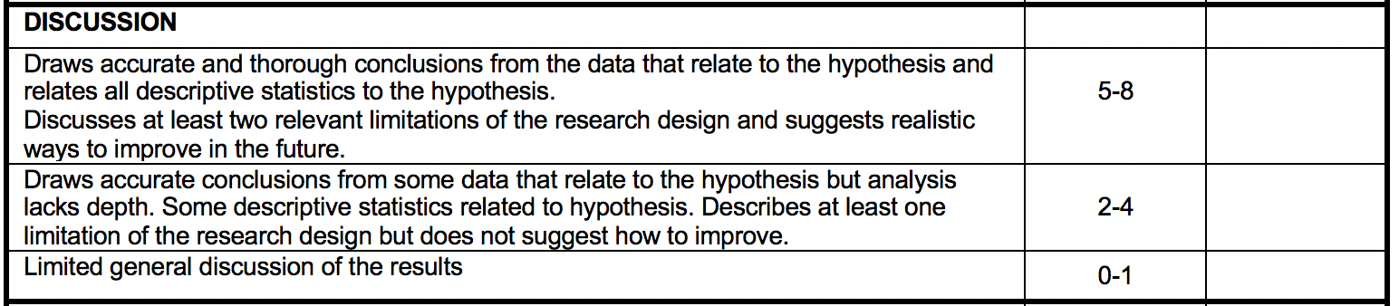
Discussion
Skill development
Step 1: Restate the hypothesis for the experiment.
‘The hypothesis of this experiment was ….’

Slide 8
With your table, on your whiteboard:
Controlled well | Uncontrolled extraneous variables

Slide 9
Discussion
Skill development
Step 2: State whether the hypothesis was supported or rejected
Step 3: Refer to your results to explain why it was supported or rejected to draw conclusions.
‘This hypothesis was supported, as depression scores were lower in the treatment condition compared to the control condition. It can therefore be concluded that the serotonin treatment assists in reducing depression in adult men.’

Slide 10
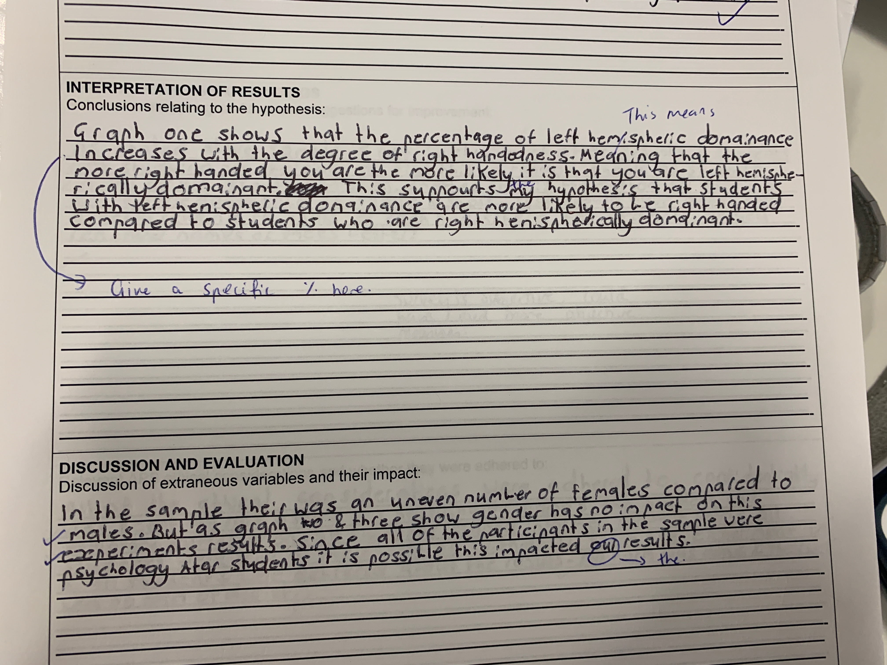
What is good?
What should be improved?

Slide 11
Discussion
Skill development
Step 4: Discuss at least two limitations of study design and suggest how to improve.
Limitations may include:
Not controlling for extraneous variables – be specific with your examples
Not a valid measure of mood or sufficient exercise to create changes in mood.
Not enough experimental conditions.
The placebo of relaxation was not a valid activity to constitute as a placebo.
Not reliable/consistent.
Not a representative sample or appropriate participant allocation method.

Slide 12
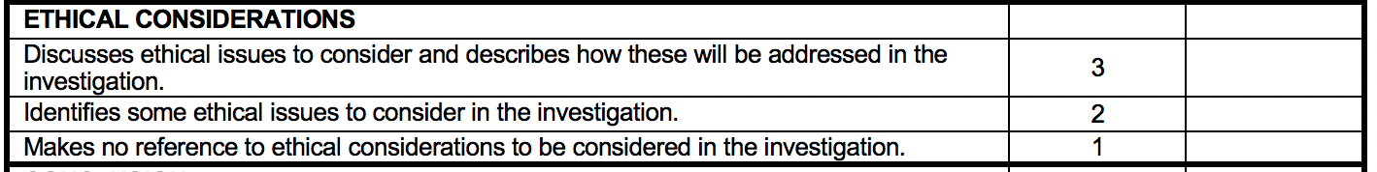
REMINDER:
You should cover HOW the researcher
(you) ensured the rights were covered).
Skill development
Participant Rights:
1. Right to Withdraw
2. Confidentiality
3. Informed Consent
4. Debrief
5. Deception
6. Protection of participants
(do no harm)
PARTICIPANT
BRIEFING

Slide 13
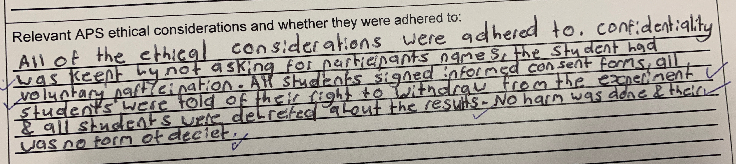
What is good?
What should be improved?

Slide 14
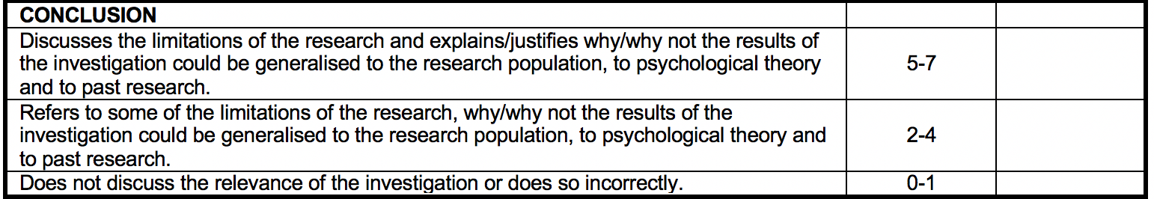
Conclusion
Skill development
Discuss the limitations and strengths of the research design in reference to:
Why/why not the results should be generalized to the wider population.
Why/why not the results should be considered as part of psychological research and theory. Does it confirm previous experiments? Does it refute previous experiments? Why?
* Make reference to the past research mentioned in your introduction

Slide 15
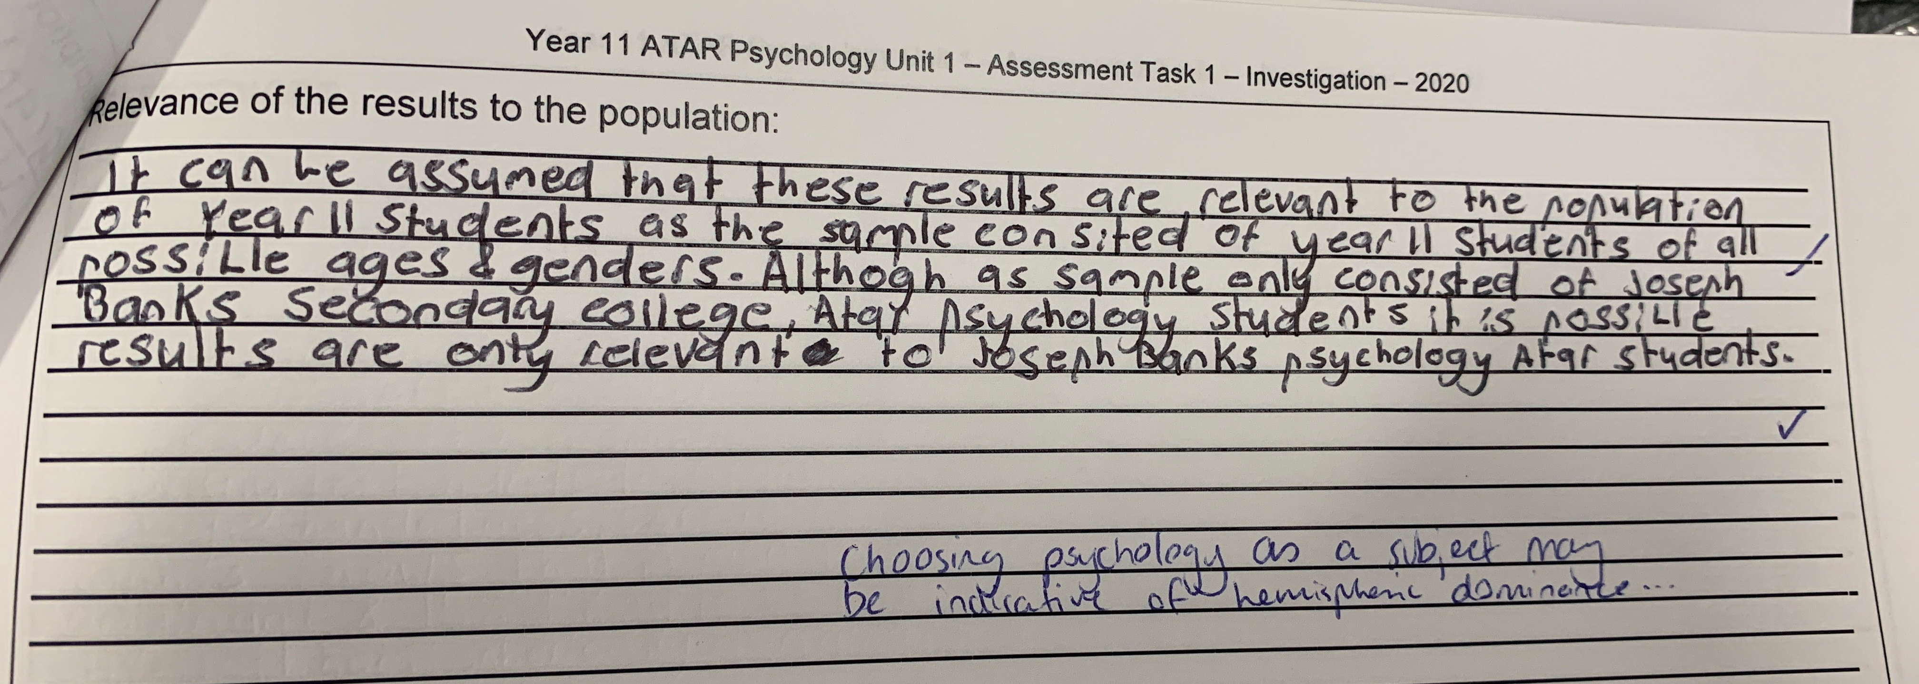
What is good?
What should be improved?

Slide 16
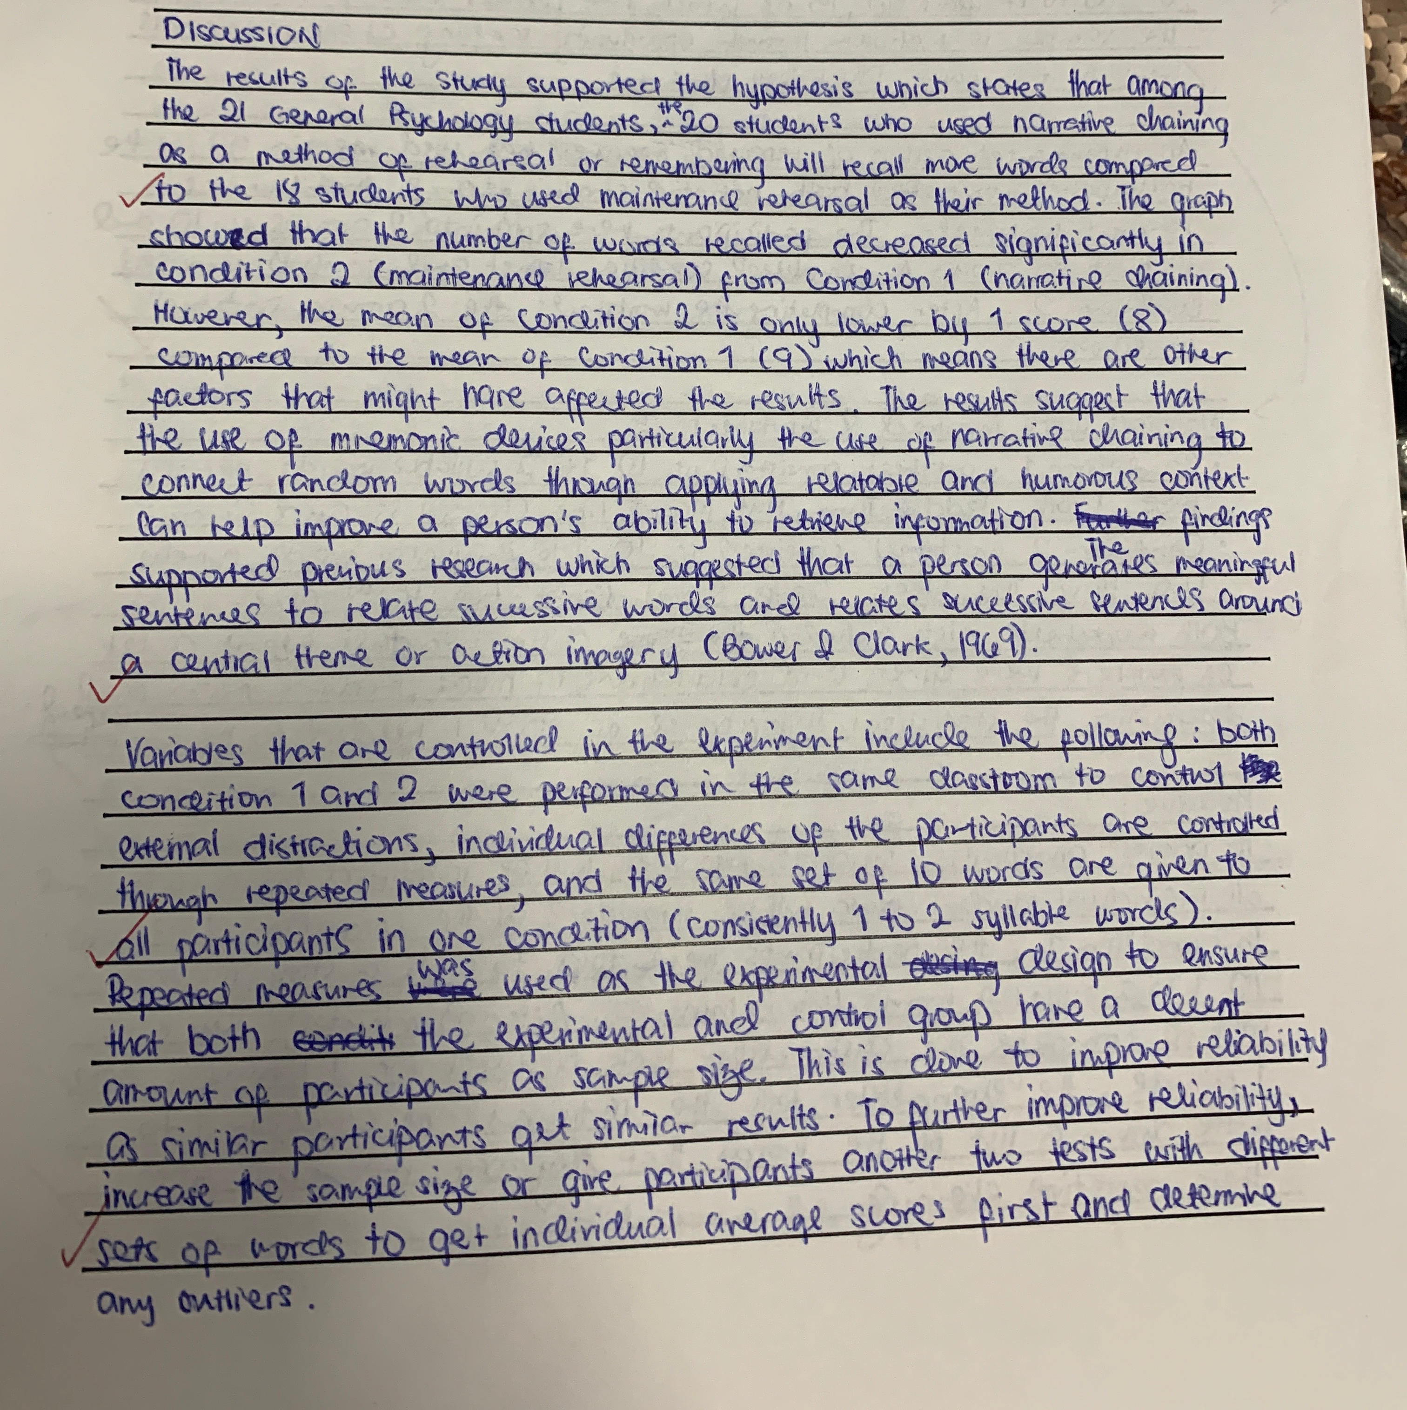
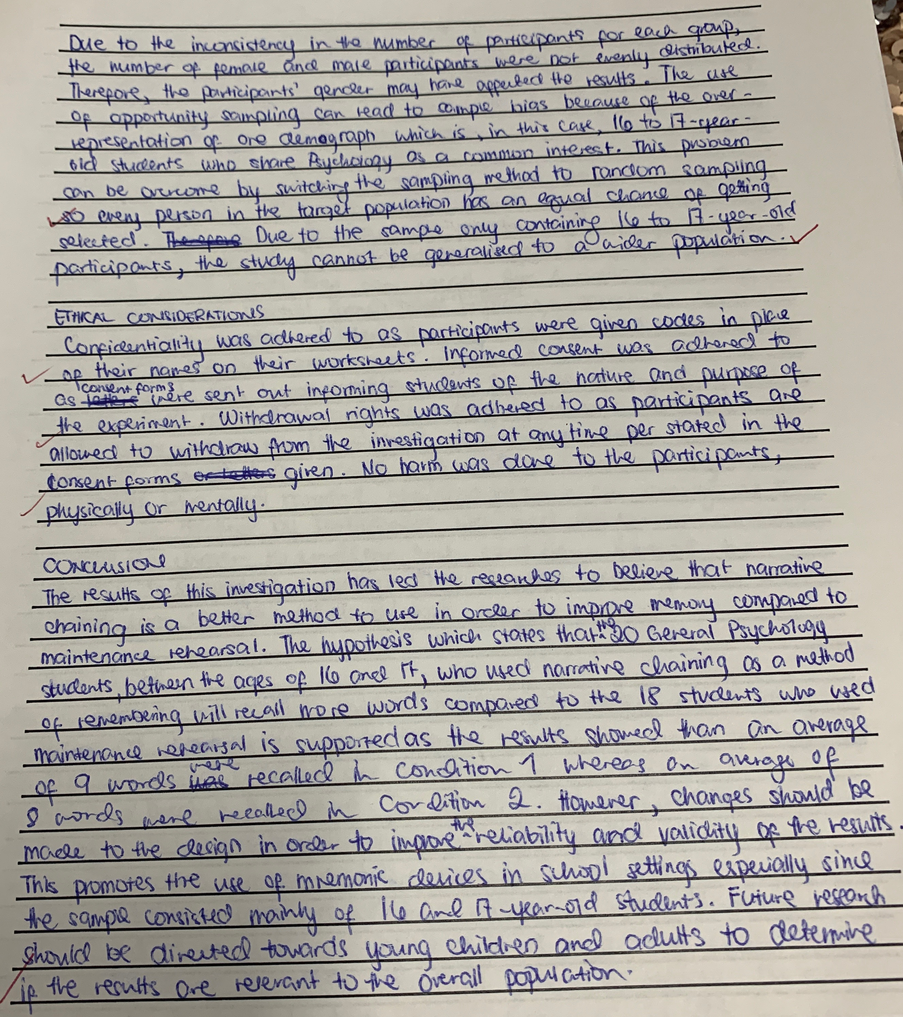

Slide 17
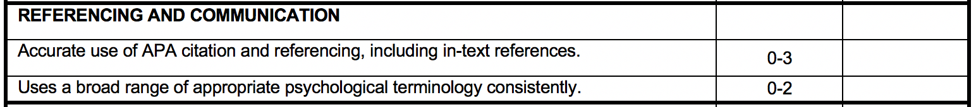
Referencing
Skill development
Make sure your submit a reference list at the end of your investigation report (in alphabetical order).
Don’t forget that you need to write in-text references as well at the end of a sentence the reference was used.
Example
In text:
According to the Australian Psychological Society (2008), substance abuse is…
or
Substance abuse is a series issue for mental health (Australian Psychological Society, 2008).
Reference for the reference list:
Australian Psychological Society. (2008). Substance abuse: Position statement. Retrieved from http://www.psychology.org.au/publications/statements/substance/

Slide 18
Referencing
Skill development
Other examples
SOURCE | How to reference at the end of the text
Web page | Australian Psychological Society. (2008). Substance abuse: Position statement. Retrieved from http://www.psychology.org.au/publications/statements/substance/
Web page: No author | Improve indigenous housing now, governments told. (2007). Retrieved from http://www.raia.com.au/i-cms?page=10220
Web page: No date | Jones, M. D. (n.d.). Commentary on indigenous housing initiatives. Retrieved from http://www.architecture.com.au
Journal article | Myre, A. S., & Door, H. (2011). The effect of mental well-being on education outcomes. Journal of Educational Psychology, 51(3), 1138-1139. Retrieved from http://www.architecture.com.au

Slide 19
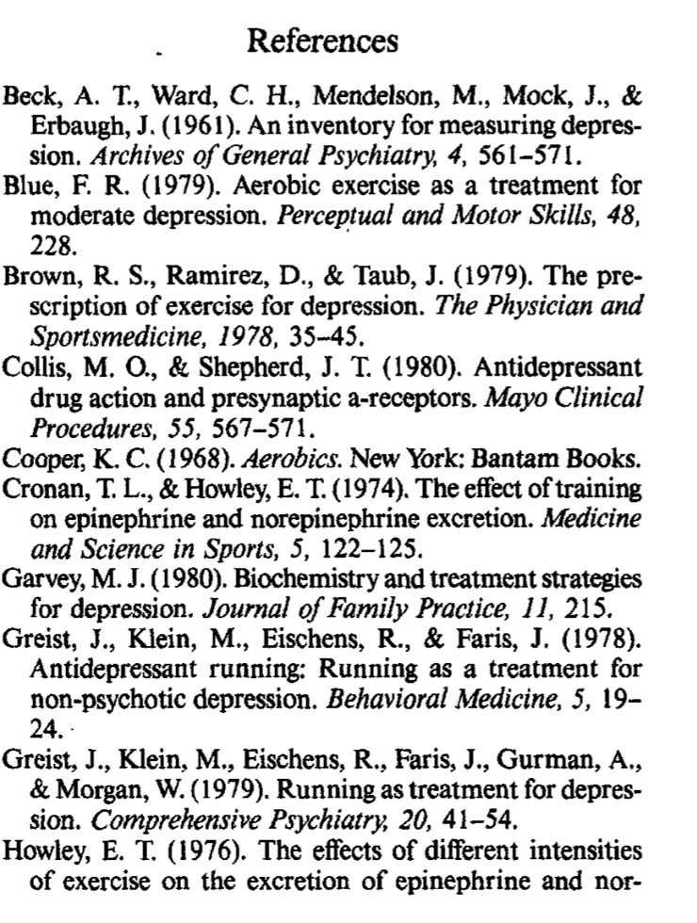
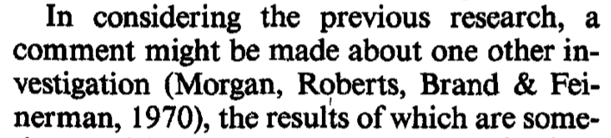
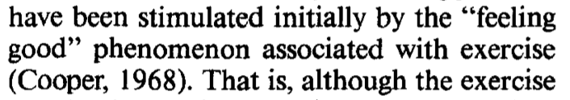
Referencing
Skill development
In-text
Referencing List

Slide 20

Homework
Before your next lesson, you must have:
DRAFTED YOUR DISCUSSION AND CONCLUSION
If you need support message me on SEQTA.

